Slide 1
Dennard Scaling
Why the future will be different

Slide 2
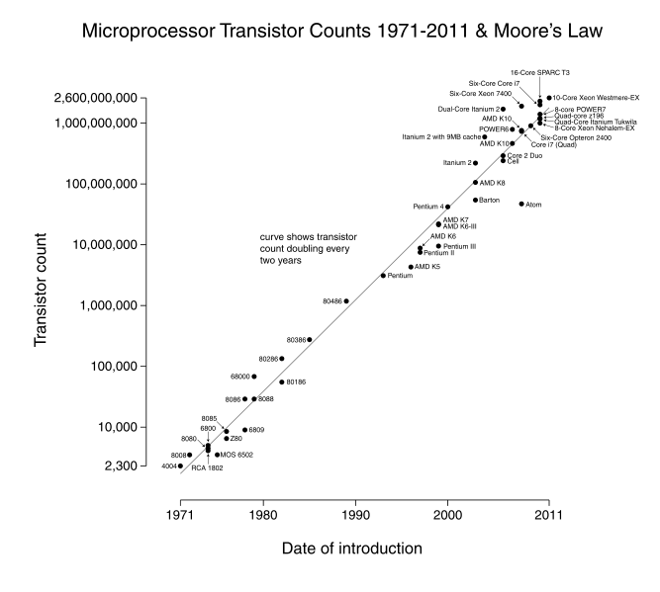

Slide 3
What does Moore’s law really say?
In 1965 Gordon Moore wrote an article for Electronics Magazine
He was asked to predict the next ten years of semiconductor development
Stated that the number of transistors would double each year.
Revised in 1975 to double every two years.
Moore didn’t know exactly why this was the case
He was viewing historical trends
In fact, shrinking dimensions on an integrated
structure makes it possible to operate the structure at
higher speed for the same power per unit area.
Notes:
Check link to article
As transistors get smaller, they get faster and operate on less power
Ties into ‘free lunch’

Slide 4
The reason Moore’s law works
In 1974, Robert Dennard and his team explained the trend Moore witnessed
Dennard Scaling
All important factors in transistor design scale down by the same constant
As they scale down, the electric field in the channel remains constant
Making transistors smaller made them better
Transistor density increased
Transistor switching delay decreased
Transistor power usage decreased

Slide 5
Dennard Scaling
V
Gate
α =1/κ
αV
Gate
Oxide
Tox
Oxide
αTox
Source
Drain
Source
Drain
L
αL
Device or Circuit Parameter | Scaling Factor
Device Dimension Tox, L, W | 1/κ
Voltage | 1/κ
Current | 1/κ
Capacitance | 1/κ
Delay time | 1/κ
Power Dissipation | 1/κ²
Notes:
The thickness of the oxide
L is channel length
As they get smaller, everything gets better – the delay time and power dissipation especially being important

Slide 6
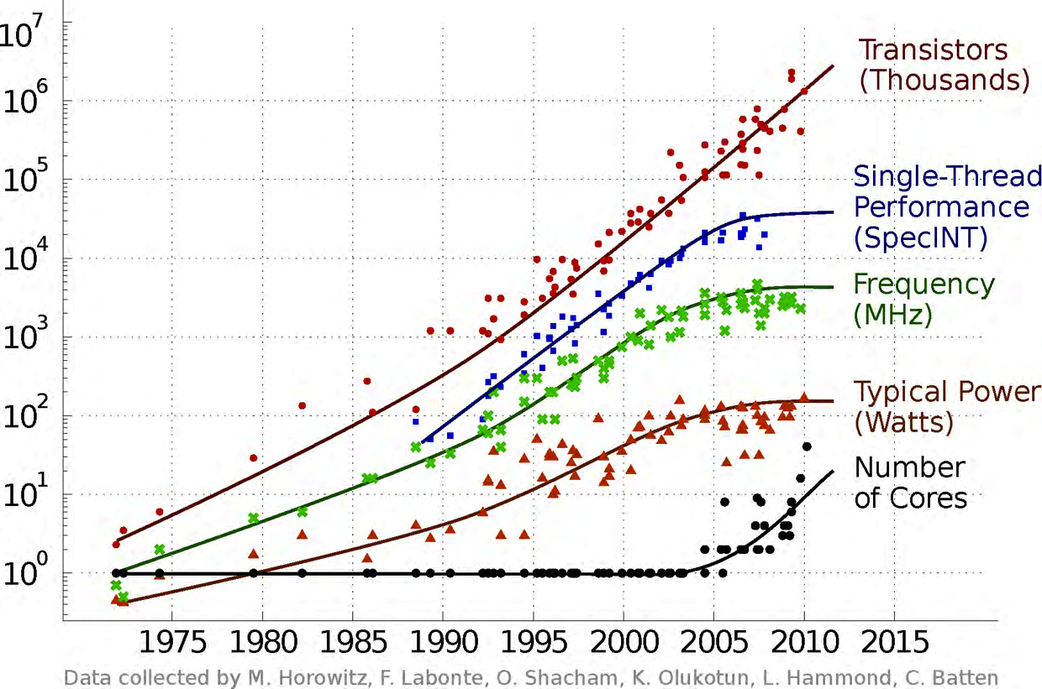
The end of Dennard scaling

Slide 7
Why is Dennard Scaling ending?
Oxide thickness (Tox) can only get so small
65 nm – Tox is 5 atoms thick
Intel has moved from 45 nm, 32 nm, and is now at 22 nm
Scaling is getting more and more difficult
Leakage current is now a problem for power consumption
Power = C_{EFF} V_{DD}² f + I_{LEAK} V_{DD}
Notes:
Thickness of trace
Leakage current causes power consumption while doing NOTHING

Slide 8
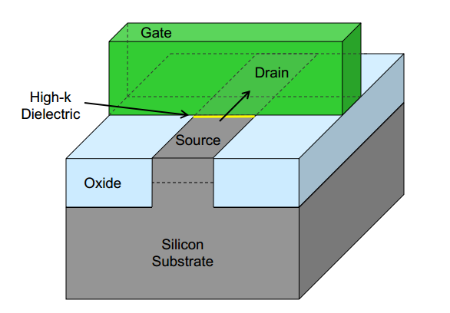
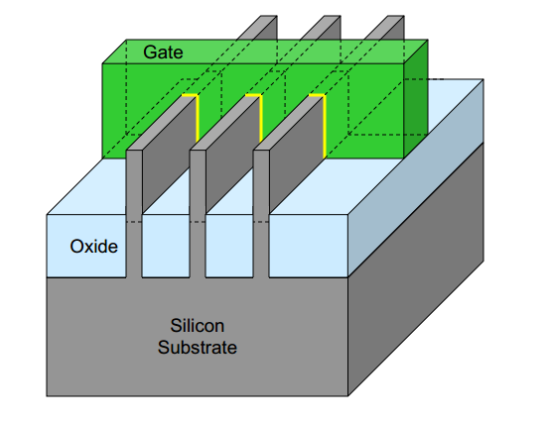
Hardware Solutions: transistor design
New transistor manufacturing techniques
Classic Transistor
Intel’s Tri-Gate Transistor
Notes:
More and more complications
Intel is beginning to miss hardware deadlines

Slide 9
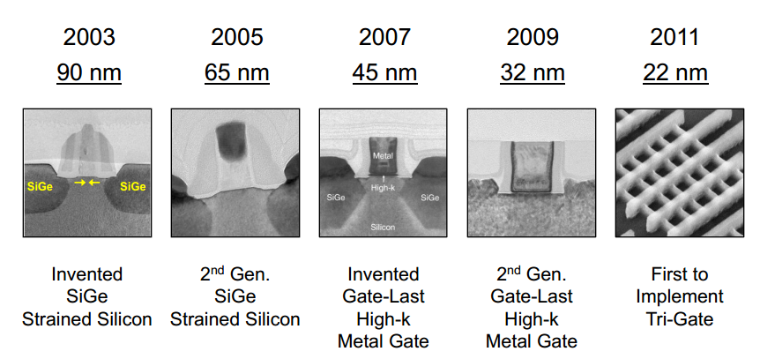
Transistor design will continue

Slide 10
Hardware Solutions: Lower Power
Power has become the leading optimization factor in two important places
The data center – due to large scale
Mobile devices – due to batteries
Options for power optimization
Turn off transistors when they are not used to eliminate loss due to leakage current
Lower V_{DD} without decreasing other dimensions
Optimize power and performance together
Notes:
* Lowering voltages reduces accuracy of transistors

Slide 11
What does all of this mean for software?
Three key conclusions (or maybe guesses)
End of transistor delay scaling
+
Moore’s Law
More CPUs and increased parallel capability
Power vs. Performance Optimization
Heterogeneous hardware:
Fast and expensive
Slow and cheap
Lower V_{DD}
Unreliable results

